Slide 1

Design and Analysis of Algorithm
Tanveer Ahmed Siddiqui

Slide 2

Analysis of Algorithm
Lecture No 7
Asymptotic Notation and Growth Rate

Slide 3
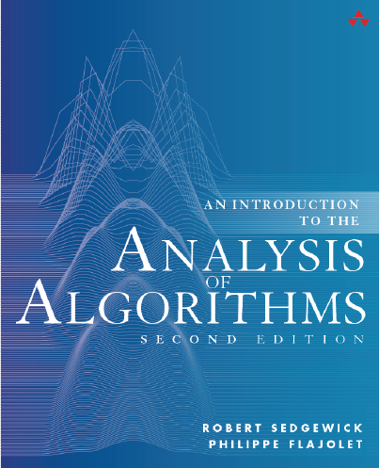
Giving credit where credit is due:
  Most of the lecture slides are based on the following Reference Book

Slide 4
Outline
What is Complexity?
  Complexity function
  Complexity Analysis
Growth of Functions
Asymptotic Notations
Usefulness of Notations
  O,Ω, Θ
Relation between O, Ω and Θ
Various examples explaining each concept

Slide 5
Classifying Functions

Slide 6



Which are more alike?

Slide 7
Which are more alike?
Mammals

Slide 8

Which are more alike?

Slide 9
Which are more alike?
Dogs

Slide 10
Classifying Animals
Vertebrates
Fish
Reptiles
Birds
Mammals
Dogs
Giraffe

Slide 11
Which are more alike?
n¹⁰⁰⁰
n²
2^{n}

Slide 12
Which are more alike?
n¹⁰⁰⁰
n²
2^{n}
Polynomials

Slide 13
Which are more alike?
1000n²
3n²
2n³

Slide 14
Which are more alike?
1000n²
3n²
2n³
Quadratic

Slide 15
Classifying Functions
Functions

Slide 16
Classifying Functions
Functions
Exp
Constant
Logarithmic
Polynomial
Exponential
Poly Logarithmic
Double Exponential
n⁵
2^{5n}
5
5 log n
(log n)⁵
n⁵
2^{5n}
2
2

Slide 17
Classifying Functions
Polynomial

Slide 18
Classifying Functions
Polynomial
Cubic
Linear
Quadratic
4th Order
5n
5n²
5n³
5n⁴

Slide 19
Asymptotic complexity

Slide 20
Growth rate
In practice, we compare different functions by measuring their growth rate.
What does growth rate of a function mean?
Growth rate of a function f(x) means how fast the value of f(x) increasing or decreasing as the value of x increases.
  For example, if f(x)=x, for every unit increase in x, the function increases by one unit but if f(x)=10x, then for every unit increase in x, the function increases by 10 units.
  This behavior of a function f(x) is called asymptotic behavior of a function.
Comparing different functions using growth rate(as a measure) implies comparing them asymptotically.

Slide 21
UP-SHOT
The asymptotic behavior of a function f(x) refers to the growth of f(x) as x gets large.

Slide 22
Growth rate
How we determine the upper bound or lower bound of growth rate of a function?
We determine by computing order of growth
What does order of growth mean?
An order of growth is a set of functions whose asymptotic growth behavior is considered equivalent.
The study of change in functional value of a function with the change in the order of the input is defined as asymptotic analysis.

Slide 23
Growth rate
How we determine the upper bound or lower bound of growth rate of a function?
We determine by computing order of growth
What does order of growth mean?
Order of growth describe different rate-of-growth relations between the defining function and the defined set of functions.
Hence, we can say:
An order of growth is a set of functions whose asymptotic growth behavior is considered equivalent.

Slide 24
Asymptotic Notations
There are three most commonly asymptotic notations
O notation:
Ω notation:
Θ notation:
asymptotic “less than”: f(n) “≤” g(n)
asymptotic “greater than”: f(n) “≥” g(n)
asymptotic “equality”: f(n) “=” g(n)

Slide 25
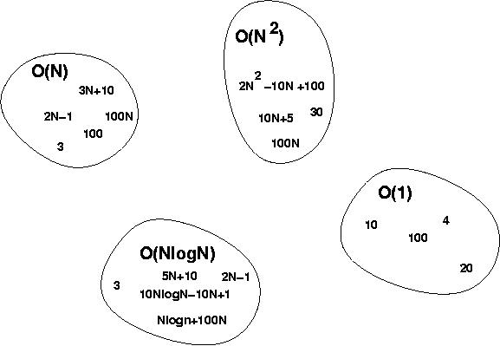
O notation
For function g(n), we define O(g(n)), big-O of n, as the set of all functions whose growth rate is the same as or lower than that of g(n).
Mathematically :
O(g(n)) = {f(n) : ∃ positive constants c and n_{0,} such that ∀n ≥ n₀, we have 0 ≤ f(n) ≤ cg(n) }

Slide 26
Point about definition
The constants c and n₀ in the definition of big-O notation are called witnesses to the relationship f (n) is O(g(n)).
To establish that f (n) is O(g(n)) we need only one pair of witnesses to this relationship. That is, to show that f (x) is O(g(x)), we need find only one pair
of constants C and n₀, the witnesses, such that |f (x)| ≤ C|g(x)| whenever x > n₀.
Remark: Note that when there is one pair of witnesses to the relationship f (x) is O(g(x)), there are infinitely many pairs of witnesses.
Notes:
Discrete Mathematics and its Applications
26年 11月 8日
(c)2001-2002, Michael P. Frank

Slide 27
Point to remember about definition
DEFINITION Let f and g be functions from the set of natural numbers to the set of real numbers. We say that f (x) is O(g(x)) if there are constants C and n₀ such that |f (x)| ≤ C|g(x)| whenever x > n₀. [This is read as “f (x) is big-oh of g(x).”]
NOTE: The particular c, n₀ , values that make the statement true are not unique: Any larger value of c and/or n0 will also work.
WORKINGWITHTHE DEFINITION OF BIG-O NOTATION A useful approach for finding a pair of witnesses is to first select a value of n₀ for which the size of |f (x)| can be readily estimated when x > n₀ and to see whether we can use this estimate to find a value of C for which |f (x)| ≤ C|g(x)| for x > n₀.
Remark: The fact that f (x) is O(g(x)) is sometimes written f (x) = O(g(x)). However, the equals sign in this notation does not represent a genuine equality. Rather, this notation tells us that an inequality holds relating the values of the functions f and g for sufficiently large numbers in the domains of these functions. However, it is acceptable to write f (x) ∈ O(g(x)) because O(g(x)) represents the set of functions that are O(g(x)).
Notes:
Discrete Mathematics and its Applications
26年 11月 8日
(c)2001-2002, Michael P. Frank

Slide 28

Visualization of O notation
  What are the roles of the two constants?
    n₀:
    c:
0
∞
n₀
f(n) ≤ c g(n)
g(n) is an asymptotic upper bound for f(n).
Comp 122

Slide 29
Point about definition
Note that f is O(g) as long as any values of c and n₀ exist that satisfy the definition.
But: The particular c, n₀ , values that make the statement true are not unique: Any larger value of c and/or n₀ will also work.
You are not required to find the smallest c and n₀ values that work.
However, you should prove that the values you choose do work.
Notes:
Discrete Mathematics and its Applications
26年 11月 8日
(c)2001-2002, Michael P. Frank

Slide 30
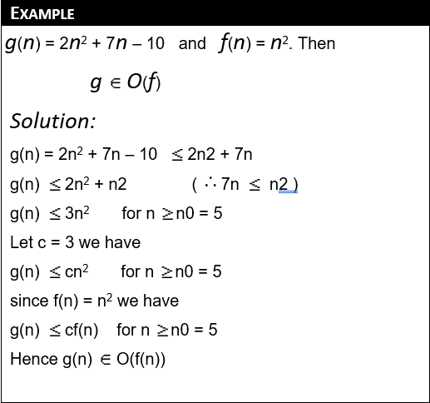
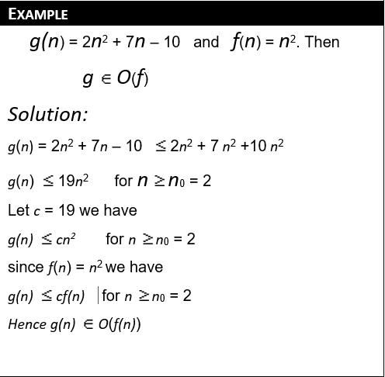
Examples: Big-O
Notes:
Discrete Mathematics and its Applications
26年 11月 8日
(c)2001-2002, Michael P. Frank

Slide 31
Examples: Big-O
Show that 30n+8 is O(n).
  Show ∃ c,n₀: 30n+8 ≤ cn, ∀n>n₀ .
    Let c=31, n₀=8. Assume n>n₀=8. Then
    cn = 31n = 30n + n > 30n+8, so 30n+8 < cn.
Show that n²+1 is O(n²).
  Show ∃c, n₀: n²+1 ≤ cn², ∀n>n₀: .
    Let c=2, n₀=1. Assume n>1. Then
    cn² = 2n² = n²+n² > n²+1, or n²+1< cn².
Notes:
Discrete Mathematics and its Applications
26年 11月 8日
(c)2001-2002, Michael P. Frank

Slide 32
Examples: Big-O, graphically
Note 30n+8 isn’t less than n anywhere (n>0).
It isn’t even less than 31n
everywhere.
But it is less than
31n everywhere to
the right of n=8.
cn =
31n
30n+8
30n+8
∈O(n)
Value of function →
n
n>n₀=8 →
Increasing n →
Notes:
Discrete Mathematics and its Applications
26年 11月 8日
(c)2001-2002, Michael P. Frank

Slide 33
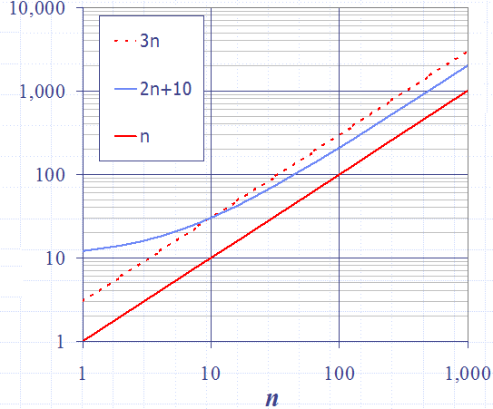
Examples
Example: 2n + 10 is O(n)
  2n + 10 ≤ cn
  (c − 2) n ≥ 10
  n ≥ 10/(c − 2)
  Pick c = 3 and n₀ = 10

Slide 34
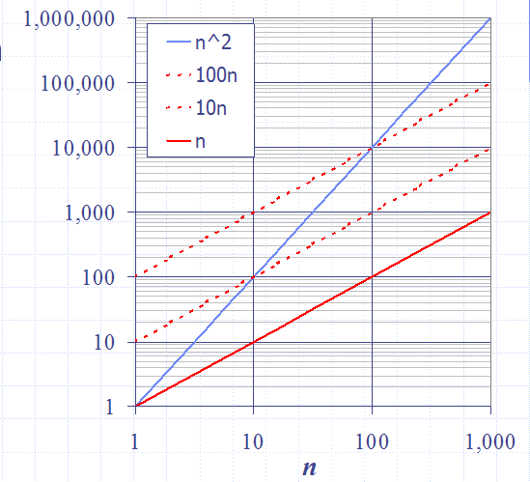
Examples
Example: the function n² is not O(n)
  n² ≤ cn
  n ≤ c
  The above inequality cannot be satisfied since c must be a constant
  n² is O(n²).

Slide 35
More Big-Oh Examples
7n-2
  7n-2 is O(n)
  need c > 0 and n₀ ≥ 1 such that 7n-2 ≤ c•n for n ≥ n₀
  this is true for c = 7 and n₀ = 1
3n³ + 20n² + 5
  3n³ + 20n² + 5 is O(n³)
  need c > 0 and n₀ ≥ 1 such that 3n³ + 20n² + 5 ≤ c•n³ for n ≥ n₀
  this is true for c = 4 and n₀ = 21
3 log n + 5
  3 log n + 5 is O(log n)
  need c > 0 and n₀ ≥ 1 such that 3 log n + 5 ≤ c•log n for n ≥ n₀
  this is true for c = 8 and n₀ = 2

Slide 36
Theorem-1
If t₁(n) є O(g₁(n)) and t₂(n) є O(g₂(n)), then
t₁(n) + t₂(n) є O(max{g₁(n),g₂(n)})
t₁(n) ≤ c₁g₁(n) for n ≥ n₀₁ and t₂(n) ≤ c₂g₂(n) for n ≥ n₀₂
t₁(n) + t₂(n) ≤ c₁g₁(n) + c₂g₂(n) for n ≥ max { n₀₁, n₀₂ }
t₁(n) + t₂(n) ≤ max{c₁, c₂} g₁(n) + max{c₁, c₂} g₂(n) for n ≥ max { n₀₁, n₀₂ }
t₁(n) + t₂(n) ≤ 2max{c₁, c₂} max{g₁(n), g₂(n) },
for n ≥ max{n₀₁, n₀₂}
c
n₀

Slide 37
Theorem- 2
Let f₁(n) = O(g₁(n) ; f₂(n) = O(g₂(n) , then
(f₁* f₂)(n) = O((g₁(n)* g₂(n))
O(N)

Slide 38
Theorem -3
If f(n) is a polynomial of degree d, then f(n) is O(n^{d}), i.e.,
  Drop lower-order terms
  Drop constant factors
Use the smallest possible class of functions
  Say “2n is O(n)” instead of “2n is O(n²)”
Use the simplest expression of the class
  Say “3n + 5 is O(n)” instead of “3n + 5 is O(3n)”

Slide 39
Ω -notation
For function g(n), we define Ω(g(n)), big-Omega of n, as set of all functions whose rate of growth is the same as or higher than that of g(n).
Mathematically:
Ω(g(n)) = {f(n) : ∃ positive constants c and n_{0,} such that ∀n ≥ n₀, we have 0 ≤ cg(n) ≤ f(n)}

Slide 40

Visualization of Ω -notation
g(n) is an asymptotic lower bound for f(n).

Slide 41
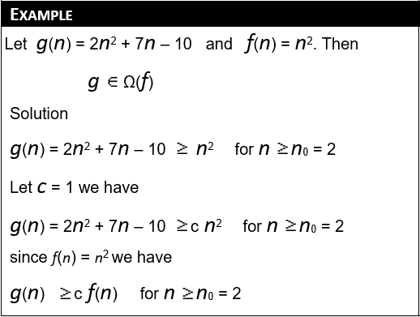
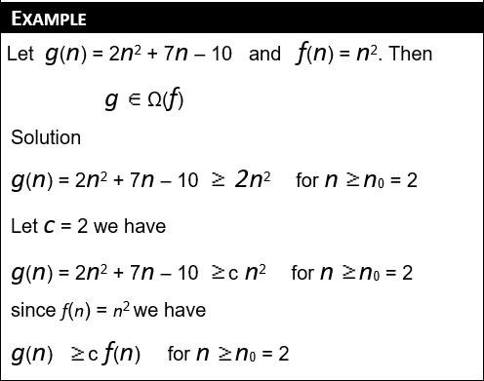
Example

Slide 42
Example
  n² = Ω(n)
  Let c = 1, n₀ = 2
  For all n ≥ 2, n² > 1 × n
Ω(g(n)) = {f(n) : ∃ positive constants c and n₀, such that ∀n ≥ n₀, we have 0 ≤ cg(n) ≤ f(n)}

Slide 43
Θ-notation
For function g(n), we define Θ(g(n)), big-Theta of n, as the set of all functions that have the same rate of growth as g(n).
Θ(g(n)) = {f(n) : ∃ positive constants c₁, c₂, and n_{0,} such that ∀n ≥ n₀, we have 0 ≤ c₁g(n) ≤ f(n) ≤ c₂g(n) }

Slide 44

Visualization of Θ -notation
g(n) is an asymptotically tight bound for f(n).

Slide 45
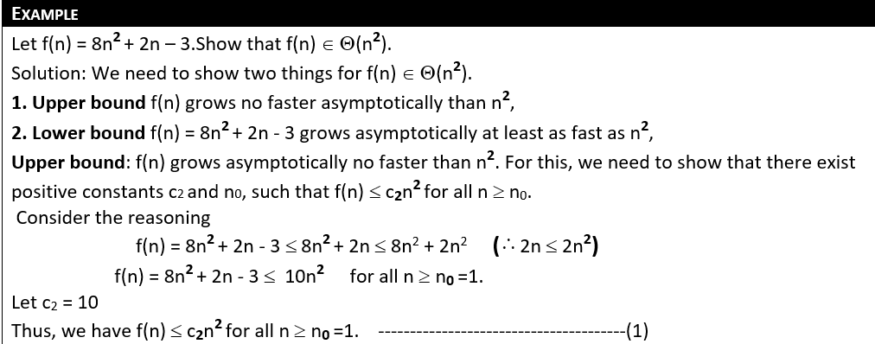
Example

Slide 46
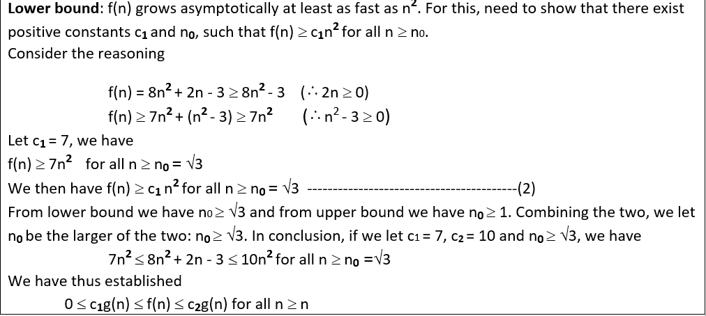
Example

Slide 47
Example
Θ(g(n)) = {f(n) : ∃ positive constants c₁, c₂, and n₀, such that ∀n ≥ n₀, 0 ≤ c₁g(n) ≤ f(n) ≤ c₂g(n)}
10n² - 3n = Θ(n²)
What constants for n₀, c₁, and c₂ will work?
Make c₁ a little smaller than the leading coefficient, and c₂ a little bigger.
To compare orders of growth, look at the leading term.
Exercise: Prove that n²/2-3n= Θ(n²)

Slide 48
Relations Between Θ, Ω, O
Theorem : For any two functions g(n) and f(n),
f(n) = Θ(g(n)) iff
f(n) = O(g(n)) and f(n) = Ω(g(n)).
i.e., Θ(g(n)) = O(g(n)) ∩ Ω(g(n))
In practice, asymptotically tight bounds are obtained from asymptotic upper and lower bounds.

Slide 49



Relations Between Θ, Ω, O
(≥) Ω(g(n)): functions that
grow at least as fast as g(n)
(=) Θ(g(n)): functions that
grow at the same rate as g(n)
g(n)
(≤) O(g(n)): functions that
grow no faster that g(n)
Θ(g(n)) = O(g(n)) ∩ Ω(g(n))

Slide 50
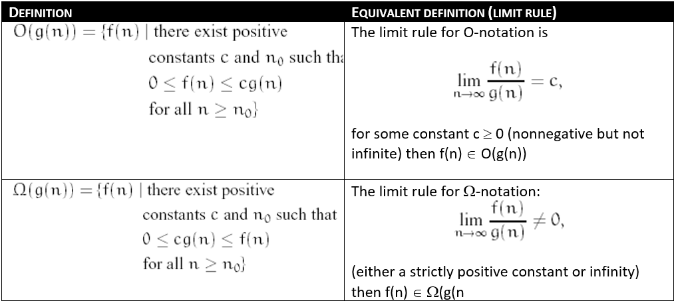
Equivalent Definition for complexity Notations

Slide 51
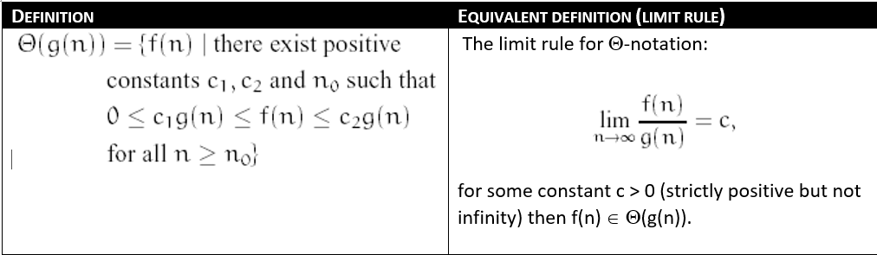
Equivalent Definition for complexity Notations

Slide 52
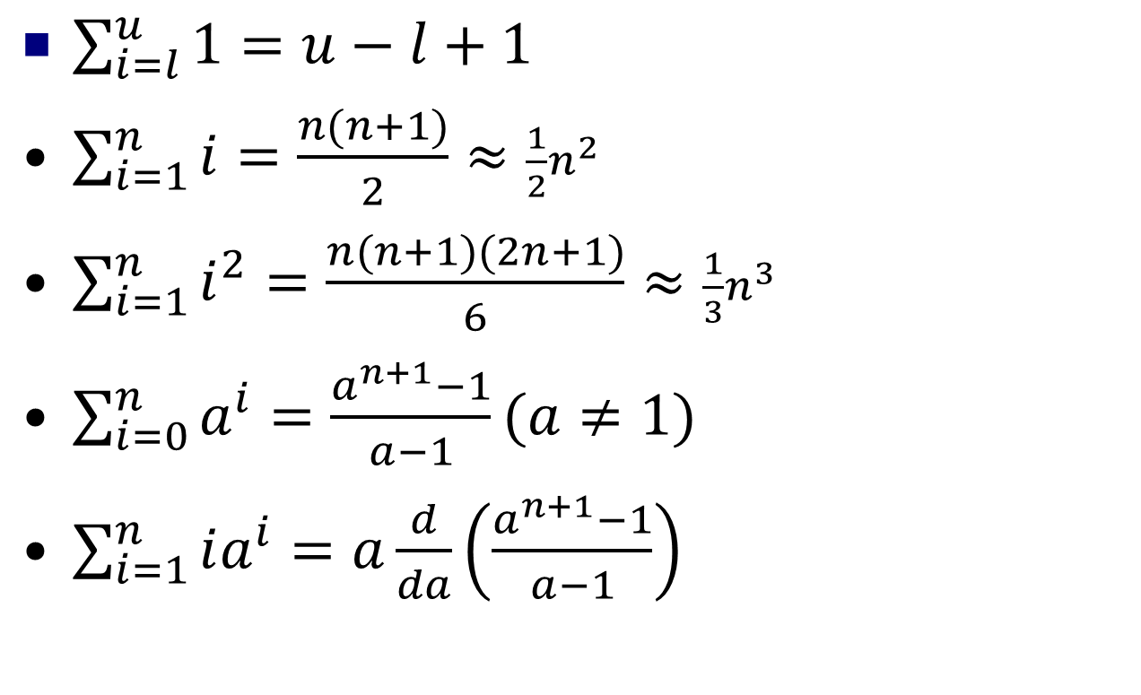
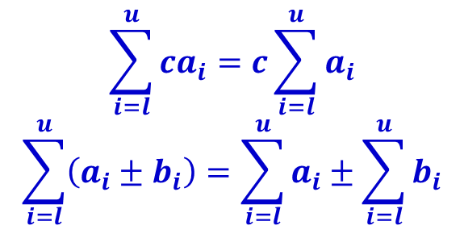
Important Summation Formulas

Slide 53
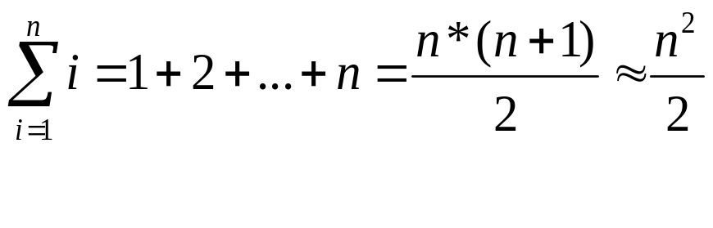
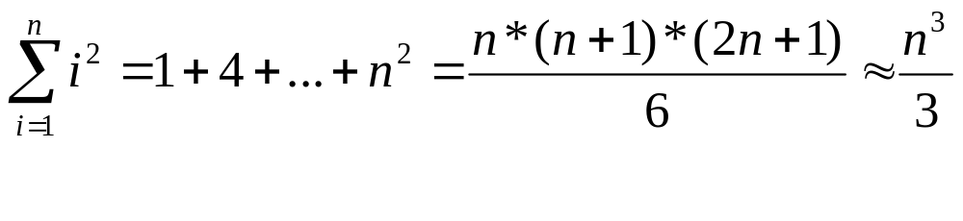
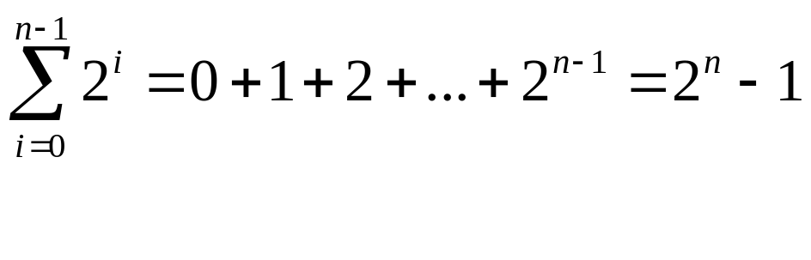
Some Mathematical Facts
Some mathematical equalities are:

Slide 54
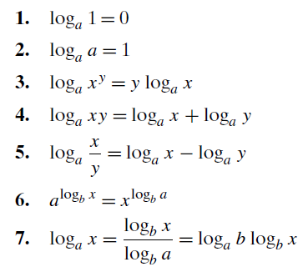
Properties of Logarithms

